Slide 1
WRAP TSC/Co-Chairs Call Workplan Progress Update December 19, 2018
Tribal Data WG
Fire and Smoke WG
Oil and Gas WG
Regional Technical Operations WG
Regional Haze Planning WG

Slide 2
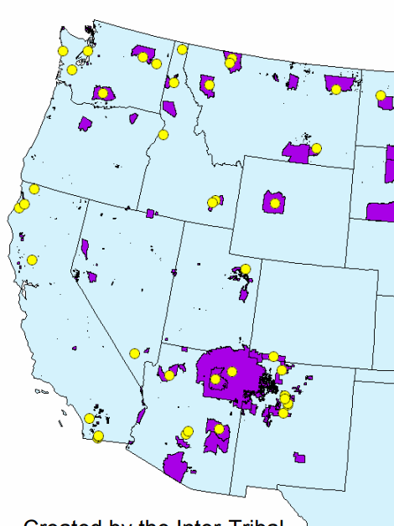
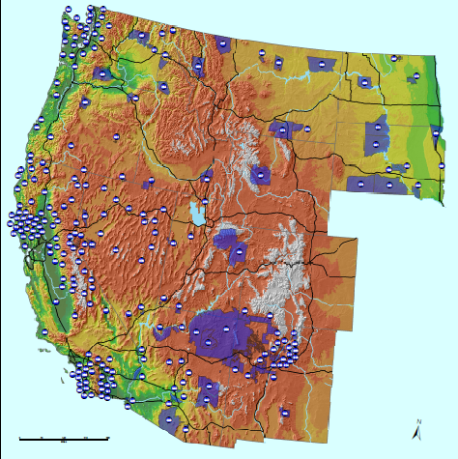
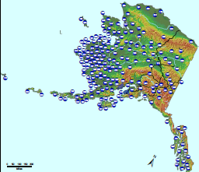
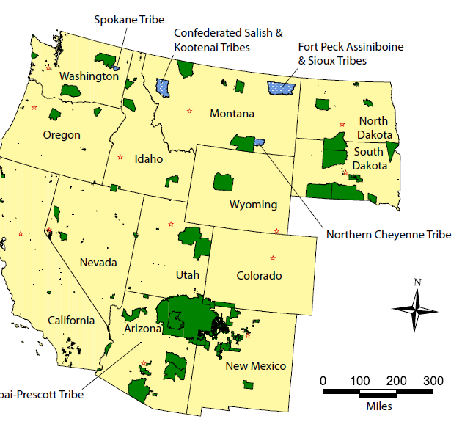
Tribal Data Work Group

Slide 3
Tribal Data Work Group
Co-Chairs: Kris Ray (Colville Tribes) and Emma Ruppell (Bishop Paiute Tribe)
Call Schedule: Monthly updates with committee and contractors
Website: http://www.wrapair2.org/tdwg.aspx (under development)
Current Tasks/Projects
Working on the Tasks in the 2018 to 19 workplan
Data analysis
Outreach

Slide 4
Tribal Data Work Group Work Products and Next Steps
Contract with the Institute of Tribal Environmental Professional at Norther Arizona University; EN3 Professionals LLC
General WRAP outreach for RH
Contact list for Tribes in the WRAP area
Map updating – create interactive maps and bring in new layers of information
Tribal AQS data gap study – which Tribes submit data and identification of issues
Tribal NEI data gap study – Identification of Tribes submitting to the NEI, Tribes conducting EI but not submitting
Tribal oil and gas EI studies – in coordination with OGWG
Consultation Protocol – process and timing of Consultation opportunities
WRAP webinars - Two or three planned, regional haze, WRAP tools, AQS or EI data
Next Steps
Monthly progress calls

Slide 5
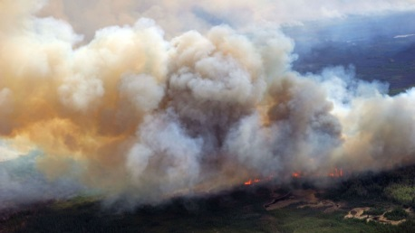
and
Fire and Smoke Work Group

Slide 6
Fire & Smoke Work Group
Co-Chairs: Sara Strachan, Josh Hall (on detail, raking)
Call Schedule: monthly or as needed
Website: http://www.wrapair2.org/FSWG.aspx
Current Tasks/Projects
2014 WRAP FNEI data review
Workplan revision

Slide 7
Status Report for Fire & Smoke Work Group
2014 WRAP FNEI data review
Approach
Revise the fire portion of the 2014 Base Year inventory
Status
Contractor, Matt Mavko, needs about 40 hours to complete revisions
Still on track to have it completed and passed to modelers by end of year/early 2019
Milestones
Discussed task during 12/13/18 workgroup call
Coordination and Next Steps
Matt will keep group notified when he completes inventory
Revising workplan (dates and deliverables) for Jan. 16 deadline
Next FSWG call: Jan. 28, presentation on Utah’s Smoke Management Plan
Gearing up for next tasks: multi-year baseline and 2028 fire inventory projections

Slide 8
Oil and Gas Work Group

Slide 9
Oil and Gas Work Group (OGWG)
Co-Chairs:
Amanda Brimmer, Regional Air Quality Council (RAQC), Denver, CO
Mark Jones, New Mexico Environment Department, Santa Fe, NM
Darla Potter, Wyoming DEQ - Air Quality Division, Cheyenne, WY
Call Schedule:
OGWG - 2nd Tuesday, every other month @ noon MT
December 11, 2018
Upcoming - Special Workplan Call January 22, 2019
Upcoming - February 12, 2019
OGWG Project Management Team (PMT) Calls – as needed
November 16
Upcoming - January 9
Representation:
Federal, state, local, TSC & other WG co-chairs, and consultants
Website:
https://www.wrapair2.org/OGWG.aspx

Slide 10
Status Report for Oil and Gas Work Group
Task 1: 2014 Base Year O&G Emissions Inventory
Approach: Contractor (Ramboll) performing work on following tasks: | Status/Deliverables
Inventory Compilation, Reconciliation, Data Gaps | Spreadsheet* + WG Discussion 8/14
2014 O&G Activity | Spreadsheet* + WG Discussion 8/14
Identify Emission Factors and Speciation Profiles for Oil and Gas Sources | PMT Discussion 8/20
State and industry survey | OGWG 10/9, PMT 9/28, 10/30, 11/16 WESTAR Council 10/10
Additional support to agencies on the survey (additional task) | Calls 12/7-11
Technical Improvements and Reporting | PMT Discussion 8/20
SMOKE-ready Emission Inventory Files | No work yet
Milestones:
Sept. 2018 – Literature review PowerPoint
Oct. 2018 – Survey finalized to send out
Apr. 2019 – SMOKE-ready 2014 O&G emissions inventory files
Coordination and Next Steps:
Assistance needed from States to complete survey (coordinate with local industry if needed)
OGWG and Project Management Team (PMT) review of draft work products
* Posted on OGWG webpage

Slide 11
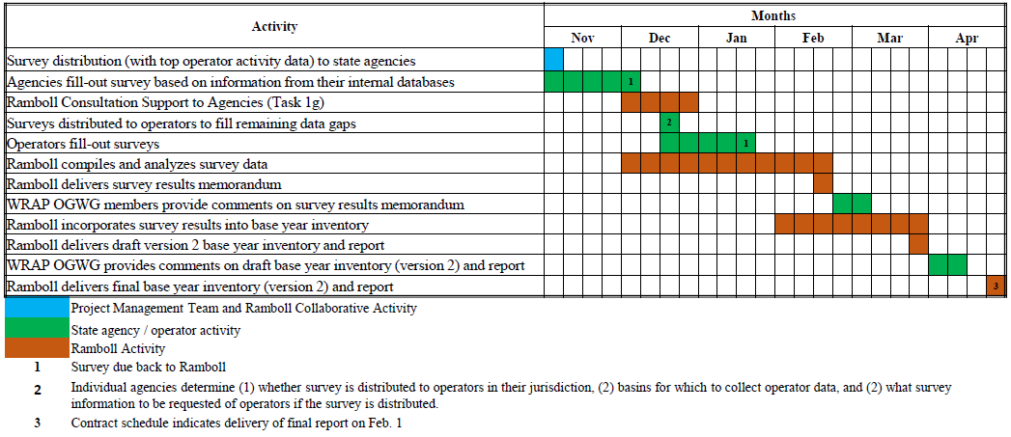
Survey Overview
Survey will be filled-out in two phases
Phase 1: Agencies fill-out survey based on internal data sets
Phase 2: Operators fill-out survey (top 3-5 operators in each basin)
12/11/18 OGWG Call

Slide 12
Status Report for Oil and Gas Work Group
Task 2: Forecast 2028 (OTB & OTW Controls) Oil & Gas Emissions Inventory
Approach: Contractor (Ramboll) performing work on following tasks: | Status
Identify historic growth, supply, demand, and production decline | Compilation Complete
Identify a Range of Forecast Year Oil and Gas Scenarios | Next Step
Identify Rule Penetration and Effectiveness for Oil and Gas Sources: National, State, Local, Tribal | No Work Yet
Implement Regionally-Consistent 2028 Forecast (OTB & OTW controls) Emissions Inventory | “
SMOKE-ready Emission Inventory Files | “
Milestones:
May 2019 – Final Report
June 2019 – SMOKE-ready 2028 O&G emissions inventory files
Coordination and Next Steps:
OGWG and Project Management Team (PMT) review of draft work products

Slide 13
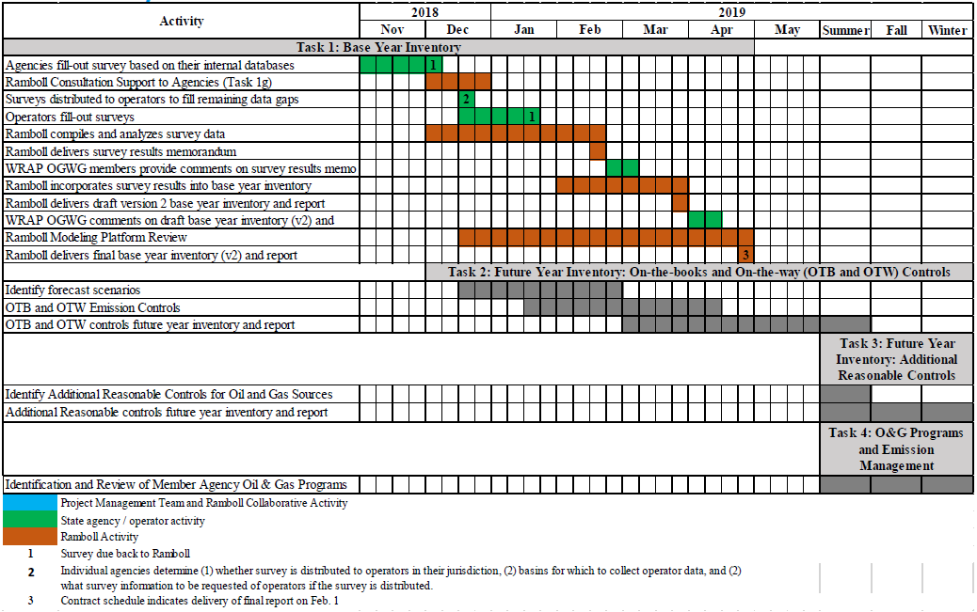
Status, Schedule & Looking Ahead
12/11/18 OGWG Call

Slide 14
Regional Technical Operations Work Group

Slide 15
RTOWG Work Group
Co-Chairs:
Gail Tonnesen (EPA R8)
Kevin Briggs (CO CDPHE)
Mike Barna (NPS ARD)
Call Schedule:
Next call: late January 2019
RTOWG co-chairs participating in other workgroup calls
Website:
http://www.wrapair2.org/RTOWG.aspx

Slide 16
Status Report for RTOWG
Joint RTOWG / Control Measures Subcommittee call, 12/12/18
Overview of Control Measures Subcommittee’s “Reasonable Progress Source Identification and Analysis Protocol” – Curt Taipale (CDPHE)
Options for Single-Source Visibility Ranking/Evaluation with Modeling Tools presentation – Ralph Morris (Ramboll)
Participated in the Monitoring Data and Glide Path Subcommittee call, 12/13/19
Participated in HAQAST haze and ozone calls; HAQAST meeting Jan. 3-4, 2019 in Phoenix

Slide 17
Status Report for RTOWG
Development of initial 2014 modeling platform
Approach
Implement an initial modeling platform for 2014
Status
Modeling contract awarded to Ramboll for phase 1
Milestones
(see following slide)
Coordination and Next Steps
~bi-weekly team calls

Slide 18
Status Report for RTOWG

Slide 19
Status Report for RTOWG

Slide 20
Regional Haze Planning Work Group

Slide 21
Regional Haze Planning Work Group
Co-Chairs: Tina Suarez-Murias (CARB) & Jay Baker (UT DEQ)
Call Schedule: 1st Tuesday every even month, noon-2PM Mountain Time
Website: https://www.wrapair2.org/RHPWG.aspx
Current Activities & Questions:
Deliverables from all five subcommittees prior to docket
Evaluating Work Group and Subcommittee Coordination, Overlap, and Roles
Figuring out task revisions for 2019 in Work Plan vs. State Responsibilities
Transition to Training for tool (deliverable) use and SIP writing
States assessing Source Controls in 2019 in order to Forecast for 2028
Notes:
Sending out a calendar list to RHPWG to keep states on track with “what’s due” Action Items
Will likely meet once a month for process and training purposes

Slide 22
Regional Haze Planning Work Group
REGIONAL HAZE (2018 Tasks) | IN PROGRESS or COMPLETE | TO DO in 2019 | ISSUES
Monitor Data Analysis | -Alternatives Analysis for MID Selection White Paper -States do Species Focus by Site -Patching/Substitution | -Glide Path Recalculation -Trends Analysis -New Natural Conditions end point only for this planning period | -Awaiting Final EPA Guidance on MID Selection (2018) and Natural Conditions (2019) -Progress Report requirements and responsibilities
Emission Inventory | -States Confirmed 2014 Inventories for most categories and completed White Paper | -Oil & Gas (Spring 2019) -Smoke & Fire (Spring 2019) -2028 Forecast and Trends | -EPA 2028 forecast from 2016 vs. 2014 differences -Multi-year Average Categories -Boundary Conditions & International Emissions
Air Quality Modeling | -Developing Categories for Source Apportionment | -Average multi-year categories -2014 Meteorology Model -Calculating RRF with MIDs | -Interplay of RHPWG & RTOWG for RH modeling -Reconciling WRAP work with EPA modeling -Is WEP necessary and affordable?
Source Analysis for Controls | -Screening Protocol White Paper | -Visibility as a Fifth Factor -Control Option “Clearinghouse”? | -States must do their own Analysis and have Emissions Reductions results by Fall 2019
Shared Database | --First Progress Report Oct. 5 -TSS v.2 ongoing development -Regional Haze Planning Overview | -Continue review of tools developed by CIRA collaborators -Develop educational and reference materials for TSS | -“Freezing” Data for Planning Purposes -Storing & Linking Reference Materials -Plan for future TSS v2 Progress Reports
Consultation & Coordination | -White Paper on Protocols | -Coordinate Training Modules -Contacts & Links | -Will Timeline & Work Plan help pace progress -Nexus between Tools, Training, & SIP Production

Slide 23
Regional Haze Planning Work Group Monitoring Data & Glide Path Status Report
Approach
Evaluate proposed EPA tracking metric with alternative extreme episodic event (E3) thresholds and other options for selecting the 20% Most Impaired Days (MID) in the west
Set up Excel spreadsheet and R code analysis to test variables on 26 representative IMPROVE sites, which each State can use to analyze their IMPROVE sites using FED dataset
Develop methodologies for evaluating Natural Condition alternative estimation techniques for future testing
Status
Recommended EPA’s proposed metric as WRAP suggested metric methodology for Most Impaired Days
Prepared draft document outlining potential alternative metrics, how to evaluate alternative, and coordination with other organizations
Contractor support to develop data substitution methodologies
Exploring ideas for natural condition estimation
Updated data evaluation tools to include 2017 datasets
Preparing draft summary documentation of work completed to date
Milestones
Subcommittee summary document draft document under Work Group review in December
Contractor preparing report documenting data patching and data substitution using State feedback
Coordination and Next Steps and Tasks
Draft summary document presented to RHPWG (all states, FLMs, tribes, EPA) for feedback
Research methodologies for Baseline and 2064 Natural Conditions adjustment (Glide Path slope and endpoints)
Coordinate with Modeling and Emission Inventory subcommittee to determine metric needs for modeling
Research methods for Uniform Rate of Progress adjustment (prescribed fire and international impacts)

Slide 24
Regional Haze Planning Work Group Shared Database Status Report
Approach
Assure that publically accessible database has useful information for states to use in SIP preparation
Work with CIRA contacts to share state needs and evaluate design of TSS v.2
Status
Reviewing Haze Analysis and Visibility Summary Tools on draft TSS v.2
Comments compiled for CIRA collaborator’s monthly response
Developing documents for eventual resource links on TSS v.2 (coordinate with other subcommittees)
Milestones
Working on titles, labels and interpretation of some graphics
Overview of Regional Haze Planning document soon to be added to docket
Draft glossary available on TSS v.2 – will be updated
Developing FAQ document
Coordination and Next Steps
Working with RHPWG and other Subcommittees on documentation needs for posting to TSSv.2 or webpage
Collaborators continue to develop updates for review – running list of most recent updates on TSS v.2 home page
Subcommittee continues to suggest improvements through the SC Lead, who consolidates repetitious comments

Slide 25
Regional Haze Planning Work Group Emissions Inventory & Modeling Protocol Status Report
Approach
Collect and collate emissions data from all states (2014 and future forecasts)
Photochemical modeling for CONUS western states
Status
State comments/revisions on emissions are being used to create documentation for the modeling contractor
Photochemical modeling contract reviewed before release
Milestones
Completed review of 2014 NEI v2 and compiled revisions requested by states into report for RHPWG review and consensus prior to docket
Coordination and Next Steps
Subcommittee Lead and Contractor formatting base year revisions into model ready format over next few weeks
Work with RTO Work Group to secure contractor for baseline and future year modeling
Get 2014 data from Oil & Gas and Fire & Smoke Work Groups model-ready by Spring 2019
Coordinate with Fire & Smoke Work Group on multi-year averages to use for future year modeling

Slide 26
Regional Haze Planning Work Group Control Measures Status Report
Approach
Develop Reasonable Progress Protocol for States to identify and assess emissions reductions from Non-Mobile Anthropogenic Sources within their State
Develop means to demonstrate these reductions improve visibility in Class I Areas
Status
Interpret EPA proposed guidance for 80% of non-mobile anthropogenic sources (facility/unit/source category)
Propose screening tools to identify sources (e.g. generally focus on SO2, SO4, NOx, and PM pollutants > 100 tpy; evaluate source emissions over distance from CIA: “Q/d > x”; and confirm sources with WRAP WEP analysis)
Milestones
Develop and circulate schedule for States’ input to other Work Groups and contractors (pending)
Draft WRAP Reasonable Progress Source Identification and Analysis Protocol to be shared with RHPWG soon
Coordination and Next Steps
Review four-factor methods and visibility impact options (e.g. plume modeling, WEP)
Work with other Work Groups on multi-year emissions averaging if needed for cost-benefit analysis or modeling
Reconcile Area Source Emissions categories vs. Stationary Source facilities with multiple units for control analysis
Determine needs for contractor assistance
Notes:
-Circulate Screening Techniques “menu” as working draft to states for use as guidance selecting “target sources”
-Meeting on Tuesday (after) this was submitted – so report anything additional

Slide 27
Regional Haze Planning Work Group Consultation and Coordination Status Report
Approach
Recommend a framework for State/State, State/Local Air Agency, State/ FLM consultation and for coordination with EPA and Tribes
Provide potential ideas for communication and outreach with stakeholders and the public
Status
Prepared and presented three-tier framework for consultation & coordination with key informal consultation junctures identified
Preparing white paper that provides more detail on the framework
Coordinating with TDWG, FLMs, EPA to develop discussion questions to guide informal consultation efforts
Milestones
Draft contractor report on Regional Haze Planning Readiness circulated to states for comment by 12/20
Consensus on 12/11 from RHPWG on three-tier framework for consultation & coordination
Coordination and Next Steps
Coordinate 2019 webinar schedule with TDWG trainings and set dates for webinars in consultation with other work groups and subcommittees
Coordinate with TDWG and FLMs to update key contact lists
Draft white paper for feedback from RHPWG
Notes:
States should review the Planning Readiness draft report (sent to state leads) and submit their comments by December 20.
The three-tier framework for informal consultation/coordination was approved by consensus by the RHPWG, which will allow the subcommittee to move forward completing the draft white paper
Look forward to a schedule of educational webinars in 2019

Slide 28
End of Workplan Progress Update

